Slide 1
Machine Learning
With Python Hands On
Kowshik Sarker
FDP by Sathyabama Institute of Science and Technology, Chennai

Slide 2


What is Machine Learning ?
Machine Learning is an idea to learn from examples and experience, without being explicitly programmed. Instead of writing code, you feed data to the generic algorithm, and it builds logic based on the data given.
“Machine Learning is the field of study that gives the computers the ability to learn without explicitly programmed” – Arthur Samuel, 1959
“A computer program is said to learn from experience E with respect to some task T and some performance measure P, if its performance on T, as measured by P, improves with experience E.” – Tom Mitchell, 1997
BIRD

Slide 3
Traditional Approach vs ML Approach
The Traditional Approach
Launch!
Study the problem
Write Rules
Evaluate
Analyze errors
The ML Approach
Data
Launch!
Study the problem
Training ML Algorithms
Evaluate
Analyze errors

Slide 4
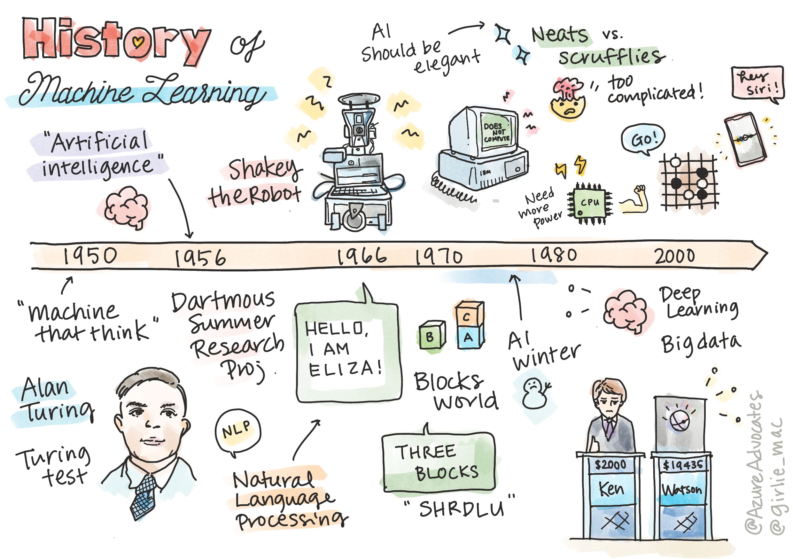
Application of Machine Learning
Applications of machine learning are now almost everywhere, and are as ubiquitous as the data that is flowing around our societies, generated by our smart phones, connected devices, and other systems.
You can use machine learning in many ways:
To predict the likelihood of disease from a patient's medical history or reports.
To leverage weather data to predict weather events.
To understand the sentiment of a text.
To detect fake news to stop the spread of propaganda.
Finance, economics, earth science, space exploration, biomedical engineering, cognitive science, and even fields in the humanities have adapted machine learning to solve the arduous, data-processing heavy problems of their domain.

Slide 5
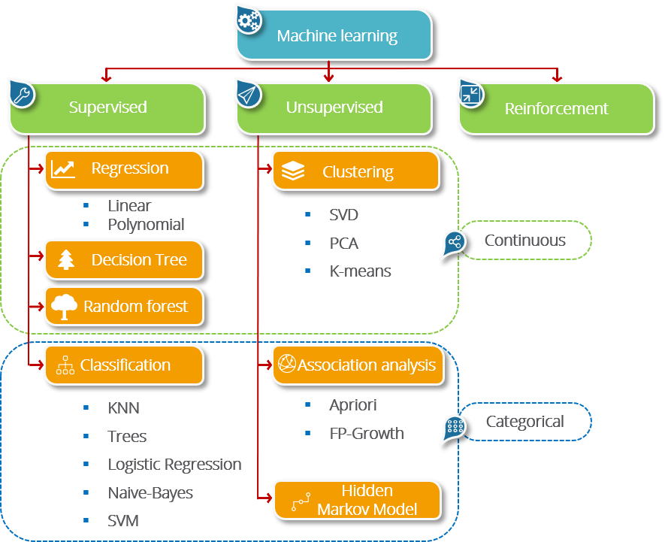
Types of Machine Learning System

Slide 6
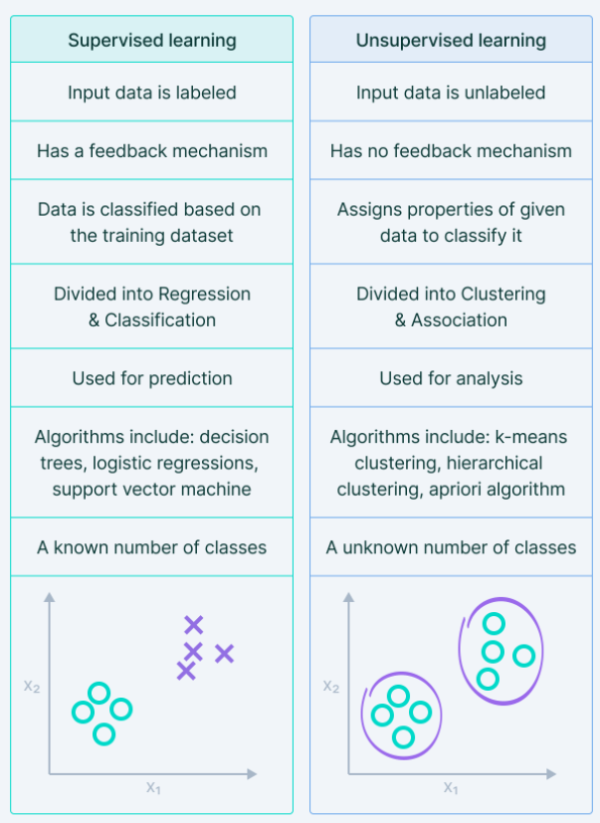
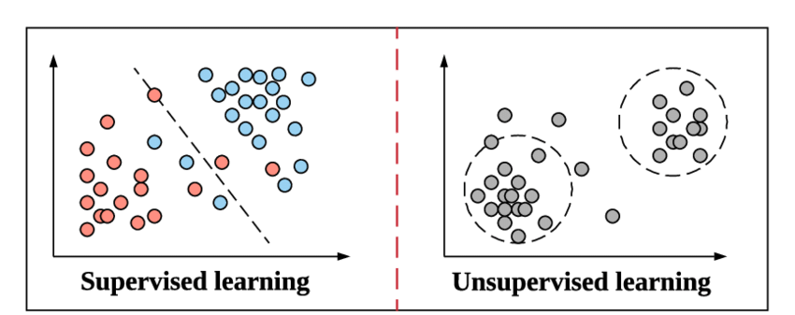
Supervised vs Unsupervised Machine Learning

Slide 7
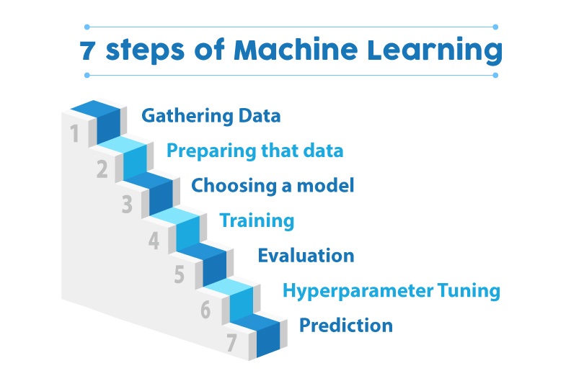

Machine Learning Steps
SELECT ME

Slide 8
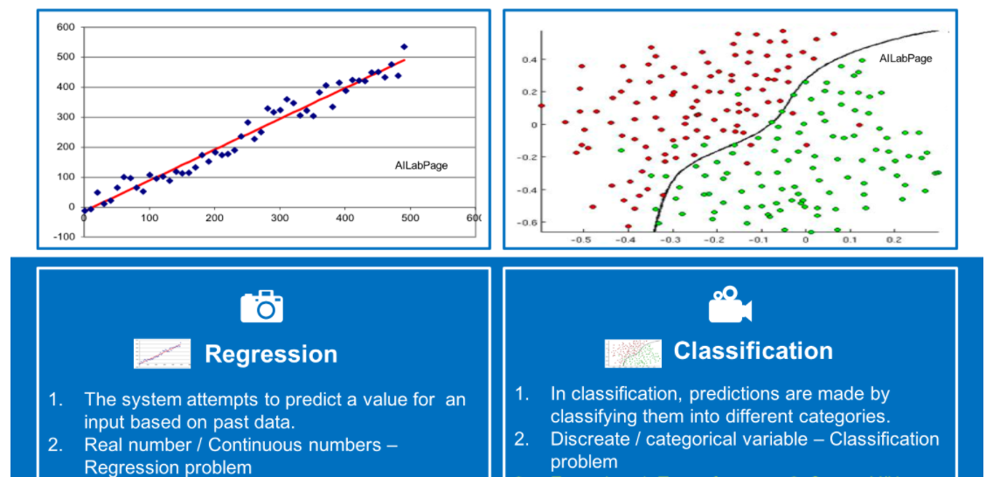
Hands On
Price Prediction Problem using Regression Algorithm Technique.
Classification problem on Spam Email Classifier

Slide 9


Thank You !!
Connect Me via Linkedin
My Blogs on Medium
My GitHub
Notes:
In Slide Show mode, select the arrows to visit links.

